Slide 1

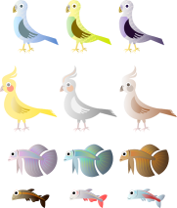
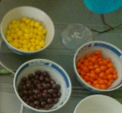
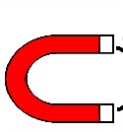



Early Years
Finding things that are similar or different
Being curious and starting to ask questions
Sorting and matching things
Performing simple tests and using equipment
Working
Scientifically is about…….
Talking about what I have done and noticed
Using senses to observe and look closely
Making simple records of what I notice or how things change
Looking closely at things and noticing changes

Slide 2





KS1
Asking questions
Explaining results- saying what we found out
Looking for patterns- sorting and grouping
Performing simple tests and using equipment
Working
Scientifically is about…….
Recording information
Saying why a test is unfair
Using books, videos, the internet, people and photos to find answers
Observing and measuring

Slide 3

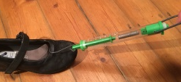
Lower
KS2
Asking relevant questions
Explaining results- drawing conclusions and using results
Looking for patterns- identifying and classifying
Setting up enquiries and choosing equipment
Working
Scientifically is about…
Choosing how to record information- tables, tally charts, Venn and Carroll diagrams and bar charts
Setting up fair tests (with help)
Recognising when to use other sources of information to find answers
Carefully observing and accurately measuring

Slide 4

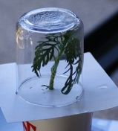


Upper
KS2
Using scientific knowledge to ask questions
Evaluating plans and results and suggesting improvements
Using scientific language to draw conclusions
Planning different types of enquiry controlling variables where necessary
Working
Scientifically is about …
Using and developing keys to identify and classify living things and materials
Accurately taking measurements using scientific equipment
Recording data, taking repeat measurements where necessary and calculating a mean
Recognising when to use other sources to answer questions and separating opinion from fact

Slide 5
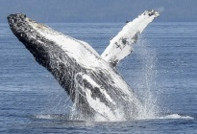
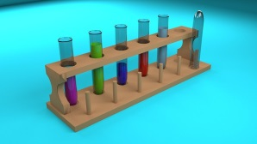





Is it by identifying and classifying something?
Is it a fair test?
Types of enquiry- what is the best way to answer my question?
Is it by using secondary sources?(books, the internet, video, an expert)?
Is it by observing something over time?
Is it by looking for a pattern?
© Herts for Learning Ltd - 2017

